Slide 1


Slide 2
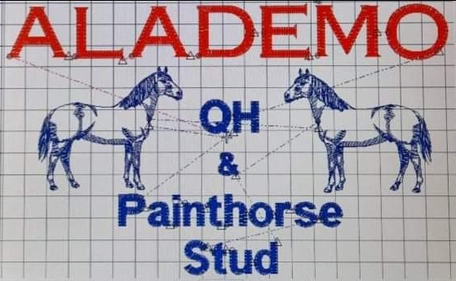

Slide 3
Allison Cousins

Slide 4
Amanda Ilka

Slide 5
Anne Edwards

Slide 6


Slide 7


Slide 8


Slide 9


Slide 10


Slide 11
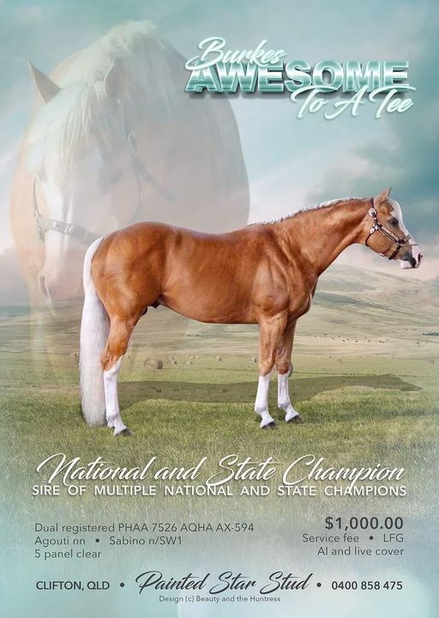

Slide 12


Slide 13
Cath Auld

Slide 14
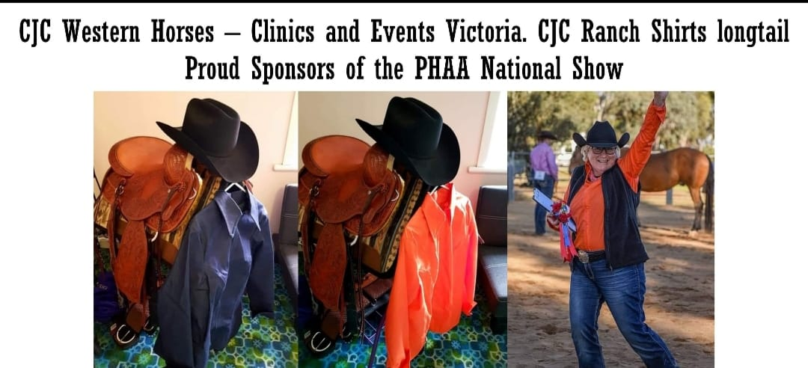

Slide 15


Slide 16


Slide 17
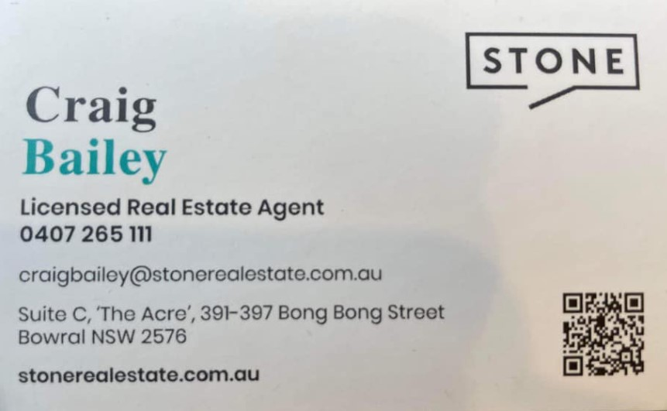

Slide 18


Slide 19


Slide 20

DD Performance Horses

Slide 21
Di & Ron Forester

Slide 22
Dion Assenbruck

Slide 23


Slide 24
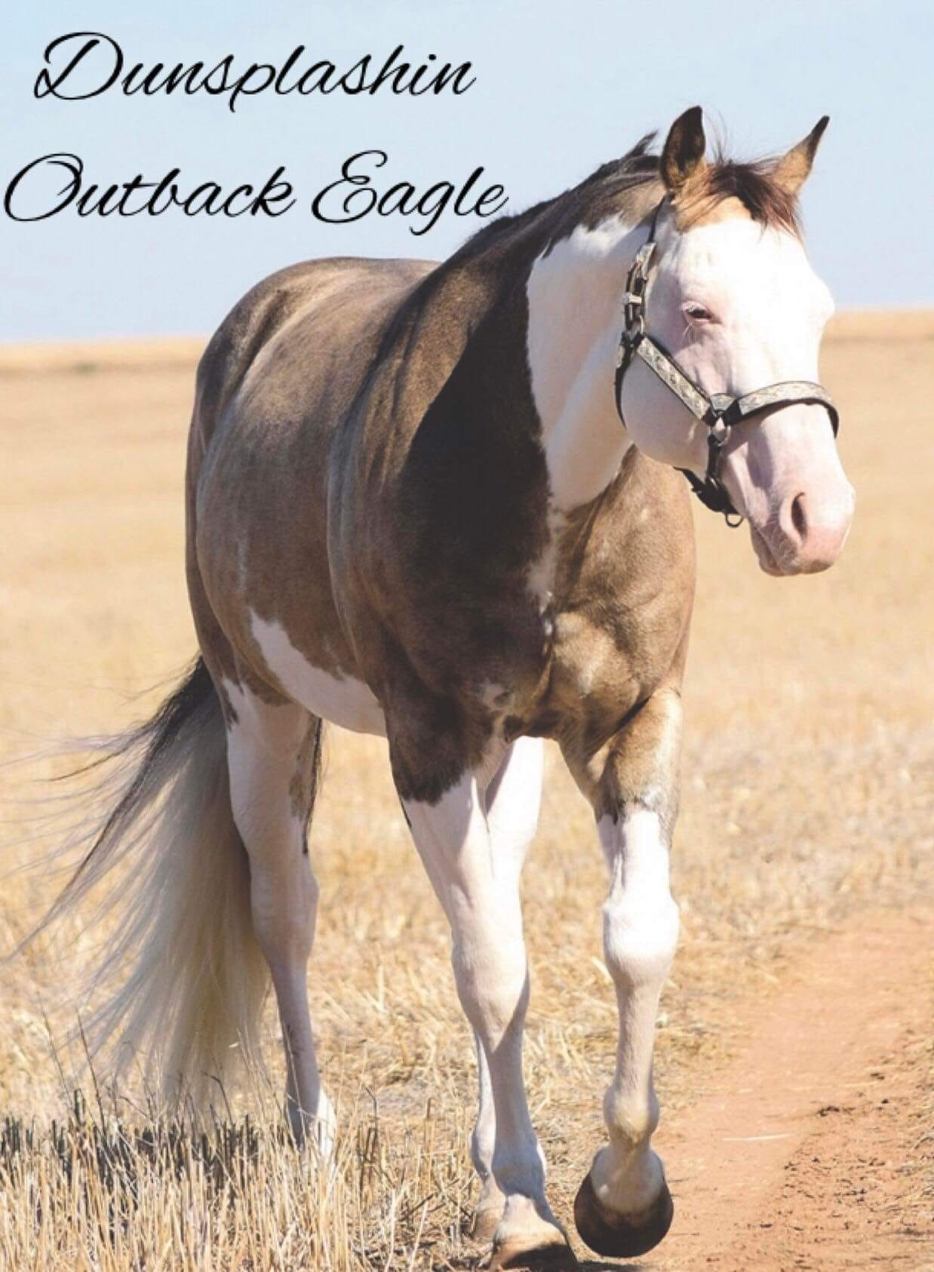

Slide 25
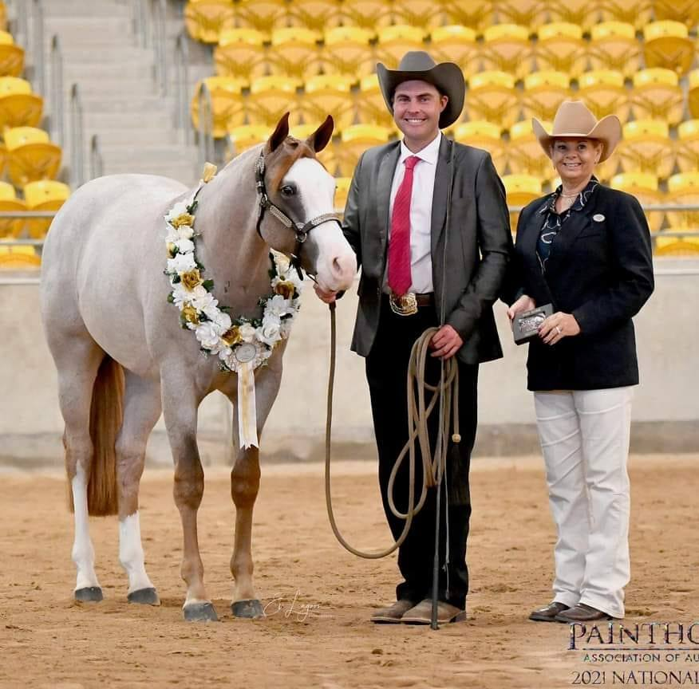
Dylan Hughes Show Horses

Slide 26


Slide 27
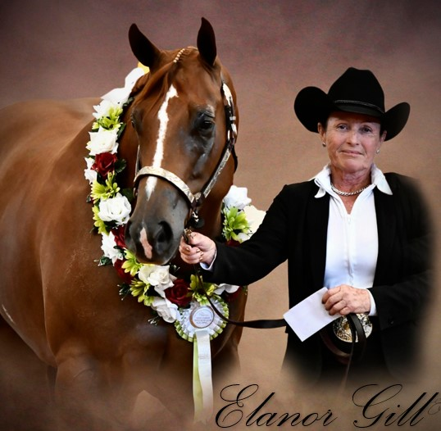

Slide 28
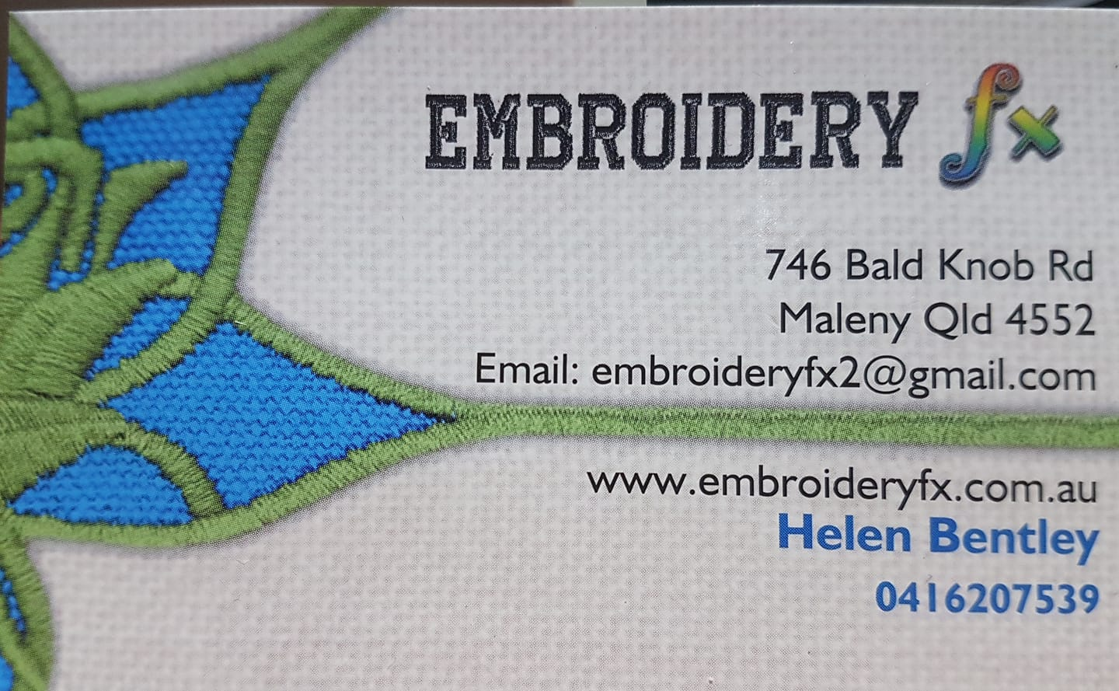


Slide 29


Slide 30
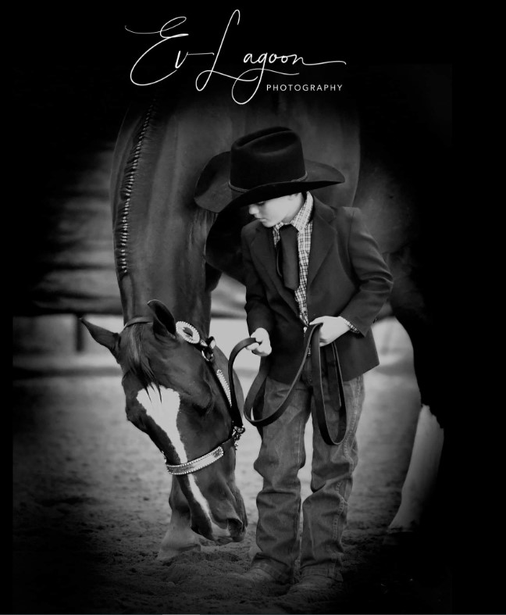

Slide 31
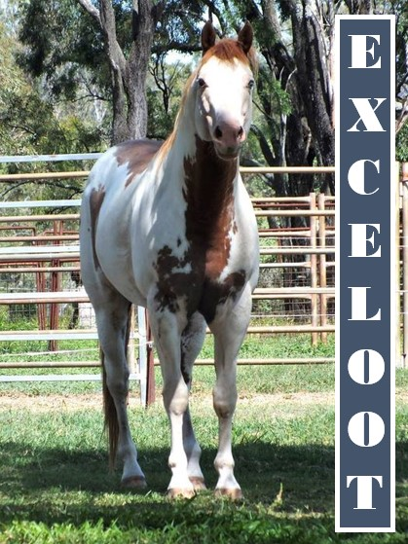

Slide 32
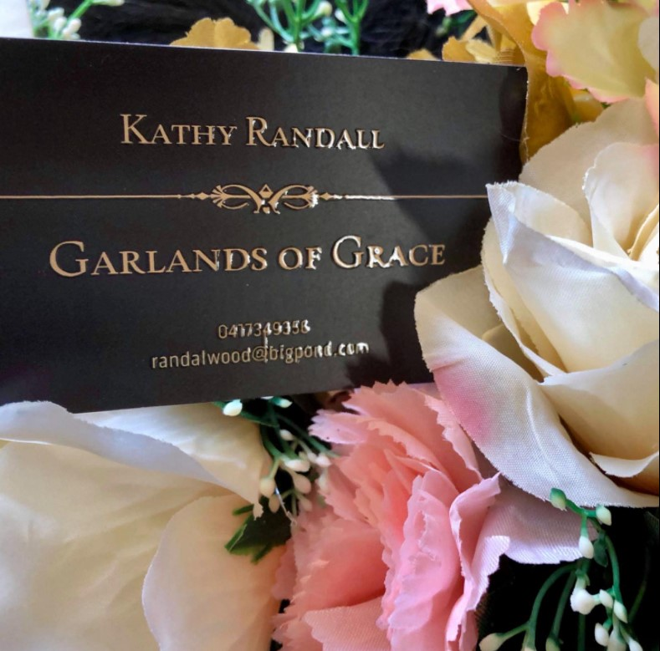

Slide 33


Slide 34


Slide 35


Slide 36
Heather Triffett

Slide 37


Slide 38


Slide 39


Slide 40
Hollie Shields

Slide 41
Irene Norris

Slide 42
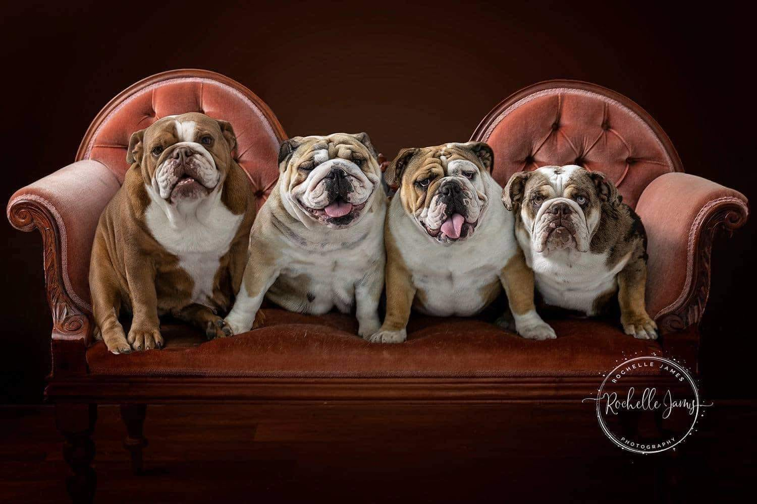

Slide 43
Johnston Family Bookkeeping
Registered BAS Agent & CPA
0438 978 518

Slide 44
Karen Oborn

Slide 45
Karin Brouggy

Slide 46


Slide 47
Kate Seccull

Slide 48
Kathy Bigwood

Slide 49


Slide 50


Slide 51


Slide 52


Slide 53
Leah Helwig

Slide 54


Slide 55
Lee Jennings

Slide 56


Slide 57
Lyn Martin

Slide 58
Lyn White

Slide 59


Slide 60
Michelle Edwards

Slide 61


Slide 62
Munn Family

Slide 63


Slide 64
Narelle Curtis

Slide 65
Natasha Peasley

Slide 66
Neva Craig

Slide 67


Slide 68
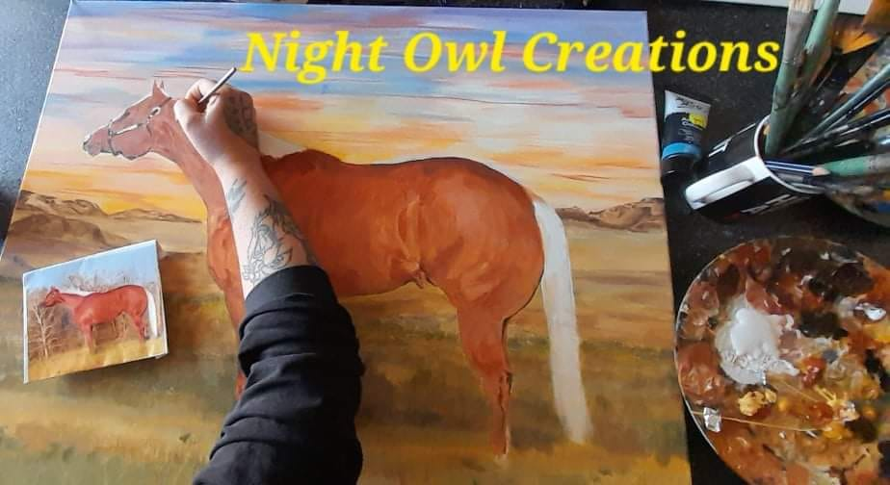

Slide 70


Slide 71


Slide 72
Peter Hall

Slide 73
Peters Family
& Jojubi

Slide 74


Slide 75


Slide 76
Rachel Longworth

Slide 77


Slide 78


Slide 79
Rebecca Stubbs

Slide 80


Slide 81
Robyn Smith

Slide 82
Robyn White

Slide 83


Slide 84
Sarah Saxer

Slide 85


Slide 86


Slide 87


Slide 88
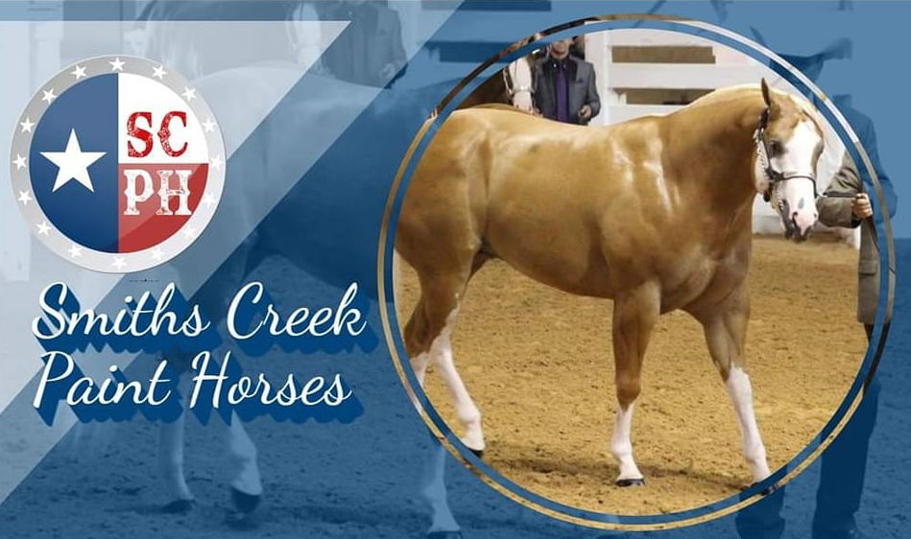

Slide 89
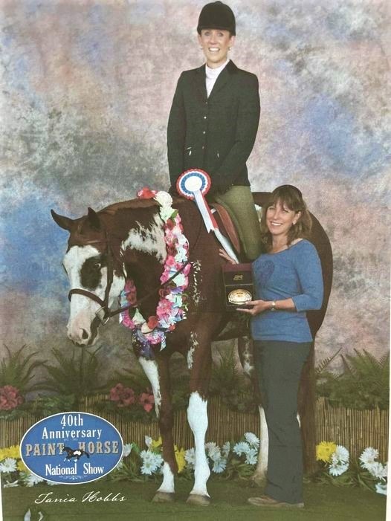
SO
HOT ‘N’
CHARMING

Slide 90


Slide 91
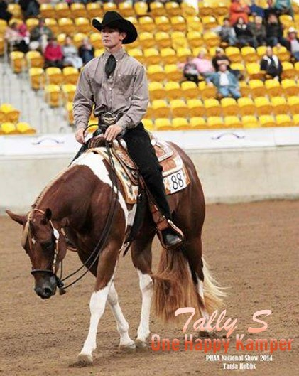

Slide 92
Tanya Pressler-Quinn

Slide 93
Tanya Thomas

Slide 94
Temika Carson

Slide 95


Slide 96
Trevor & Anne Phillips

Slide 97


Slide 98


Slide 99
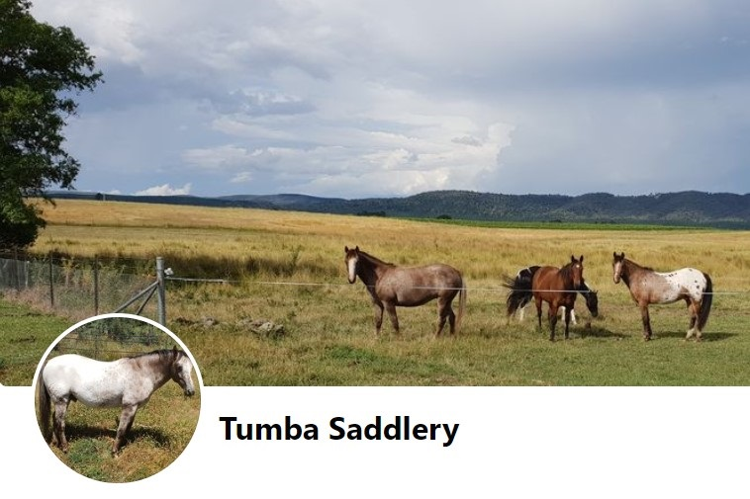

Slide 100
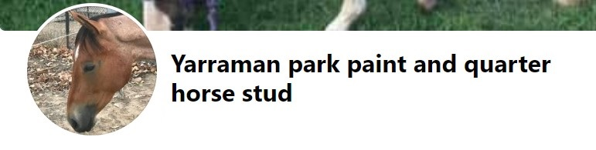

Slide 101
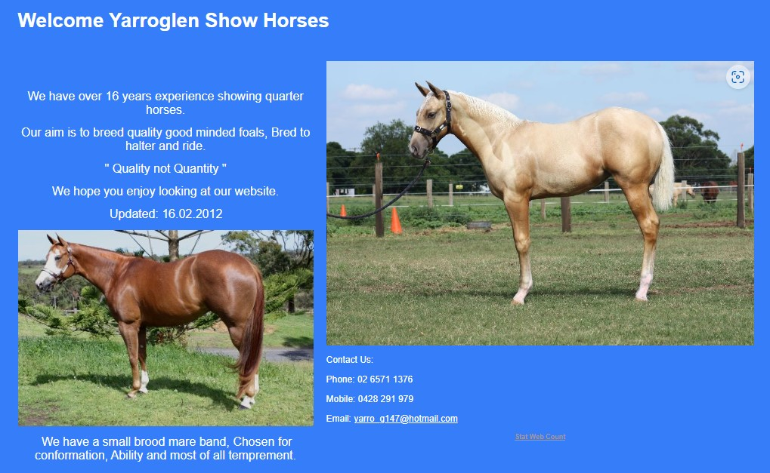

Slide 102
Zan & Tiarna Russ

